Slide 1
Introduction to ARM (Acorn/Advanced Risc Machines)
Gananand Kini
June 18 2012

Slide 2
Acknowledgements
Prof. Rajeev Gandhi, Dept. ECE, Carnegie Mellon University
Prof. Dave O’Hallaron, School of CS, Carnegie Mellon University
Xeno Kovah
Dana Hutchinson
Dave Keppler
Jim Irving
Dave Weinstein
Geary Sutterfield
…

Slide 3
Co-requisites
Intro x86
Intermediate x86 – would be very helpful

Slide 4
Book(s)
“ARM System Developer's Guide: Designing and Optimizing System Software” by Andrew N. Sloss, Dominic Symes, and Chris Wright

Slide 5
Schedule
Day 1 Part 1
Intro to ARM basics
Lab 1 (Fibonacci Lab)
Day 1 Part 2
More of ARMs features
Lab 2 (BOMB Lab)
Day 2 Part 1
ARM hardware features
Lab 3 (Interrupts lab)
Day 2 Part 1.5
GCC optimization
Lab 4 (Control Flow Hijack Lab)
Day 2 Part 2
Inline and Mixed assembly
Atomic instructions
Lab 5 (Atomic Lab)

Slide 6
Day 1 Part 1

Slide 7
Introduction
Started as a hobby in microcontrollers in high school with robotics
Background in software development and electrical engineering
In school, took many courses related to micro controllers and computer architecture
Small amount of experience with assembly

Slide 8
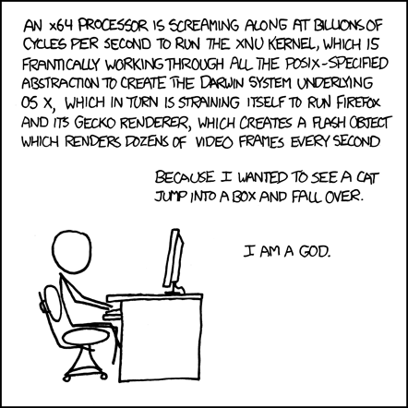
Obligatory XKCD
Source: http://xkcd.com/676/

Slide 9
Short Review
short ByteMyShorts[2] = {0x3210, 0x7654} in little endian?
Answer: 0x10325476
int NibbleMeInts = 0x4578 in binary, in octal? (no endianness involved)
Answers: 0b0100 0101 0111 1000
0b0 100 010 101 111 000
0o42570 (Take 3 bits of binary and represent in decimal)
Two’s complement of 0x0113
Answer: 0xFEED
What does the following code do? (Part of output from gcc at –O3)
movl (%rsi), %edx
movl (%rdi), %eax
xorl %edx, %eax
xorl %eax, %edx
xorl %edx, %eax
movl %edx, (%rsi)
movl %eax, (%rdi)
ret
How can we optimize above for code size?
Could this macro be used for atomic operations?
Notes:
Source: http://stackoverflow.com/questions/8567609/variable-swap-with-and-without-auxiliary-variable-which-is-faster

Slide 10
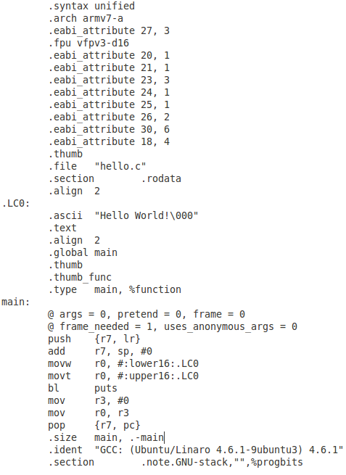
We’ll learn how and why
This turns into…
int main(void) {
printf(“Hello world!\n”);
return 0;
}

Slide 11

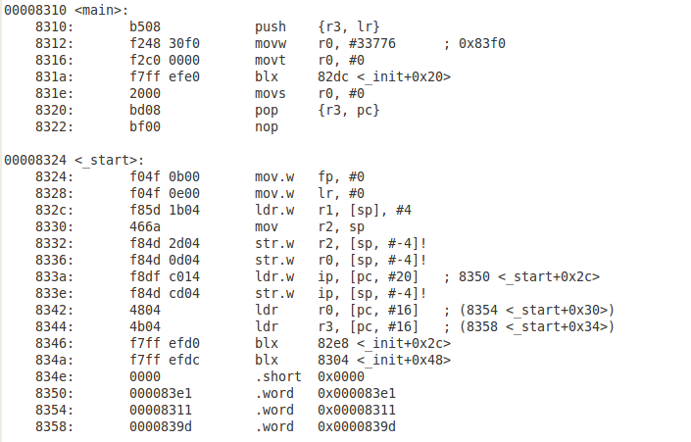
And then into the following
Generated using objdump

Slide 12

Introduction to ARM
Acorn Computers Ltd. (Cambridge, England) Nov. 1990
First called Acorn RISC Machine, then Advanced RISC Machine
Based on RISC architecture work done at UCal Berkley and Stanford
ARM only sells licenses for its core architecture design
Optimized for low power & performance
VersatileExpress board with Cortex-A9 (ARMv7) core will be “emulated” using Linaro builds.
This also means some things may not work. You’ve been warned.
Notes:
RISC which stands for Reduced Instruction Set computing is an idea that simple instructions can provide higher performance if this enables faster execution of each instruction

Slide 13
ARM architecture versions
Architecture | Family
ARMv1 | ARM1
ARMv2 | ARM2, ARM3
ARMv3 | ARM6, ARM7
ARMv4 | StrongARM, ARM7TDMI, ARM9TDMI
ARMv5 | ARM7EJ, ARM9E, ARM10E, Xscale
ARMv6 | ARM11, ARM Cortex-M
ARMv7 | ARM Cortex-A, ARM Cortex-M, ARM Cortex-R
ARMv8 | Not available yet. Will support 64-bit addressing + data
“ARM Architecture.” Wikipedia, The Free Encyclopedia. Wikimedia Foundation, Inc. 3 March 2012. Web. 3 March 2012.

Slide 14
ARM Extra Features
Similar to RISC architecture (not purely RISC)
Variable cycle instructions (LD/STR multiple)
Inline barrel shifter
16-bit (Thumb) and 32-bit instruction sets combined called Thumb2
Conditional execution (reduces number of branches)
Auto-increment/decrement addressing modes
Changed to a Modified Harvard architecture since ARM9 (ARMv5)
Extensions (not covered in this course):
TrustZone
VFP, NEON & SIMD (DSP & Multimedia processing)

Slide 15
Registers
Total of 37 registers available (including banked registers):
30 general purpose registers
1 PC (program-counter)
1 CPSR (Current Program Status Register)
5 SPSR (Saved Program Status Register)
The saved CPSR for each of the five exception modes
Several exception modes
For now we will refer to “User” mode

Slide 16
Registers
r0
r1
r2
Stack Pointer (SP) – The address of the top element of stack.
Link Register (LR) – Register used to save the PC when entering a subroutine.
Program Counter (PC) – The address of next instruction. (ARM mode points to current+8 and Thumb mode points to current+4)
Current Program Status Register (CPSR) – Results of most recent operation including Flags, Interrupts (Enable/Disable) and Modes
R12 or IP is not instruction pointer, it is the intra procedural call scratch register
r3
r4
r5
r6
r7
r8
r9
R10 (SL)
r11 (FP)
r12 (IP)
r13 (SP)
r14 (LR)
r15 (PC)
CPSR

Slide 17
Instruction cycle
Start
Fetch – fetch next instruction from memory
Execute – execute fetched instruction
Decode – decode fetched instruction
End

Slide 18
ARM vs. x86
Endianness (Bi-Endian)
Instructions are little endian (except on the –R profile for ARMv7 where it is implementation defined)
Data endianness can be mixed (depends on the E bit in CPSR)
Fixed length instructions
Instruction operand order is generally: OP DEST, SRC (AT&T syntax)
Short instruction execution times
Register differences (CPSR, SPSR…)
Has a few extra registers
Operations only on registers not memory (Load/Store architecture)
Pipelining & Interrupts
Exceptions
Processor Modes
Code & Compiler optimizations due to the above differences

Slide 19

ARM Data sizes and instructions
ARMs mostly use 16-bit (Thumb) and 32-bit instruction sets
32-bit architecture
Byte = 8 bits (Nibble is 4 bits) [byte or char in x86]
Half word = 16 bits (two bytes) [word or short in MS x86]
Word = 32 bits (four bytes) [Doubleword or int/long in MS x86]
Double Word = 64 bits (eight bytes) [Quadword or double/long long in MS x86]
Source: http://stackoverflow.com/questions/39419/visual-c-how-large-is-a-dword-with-32-and-64-bit-code

Slide 20
The Life of Binaries
Starts with c or cpp source code written by us
A compiler takes the source code and generates assembly instructions
An assembler takes the assembly instructions and generates objects or .o files with machine code
The linker takes objects and arranges them for execution and generates an executable. (A dynamic linker will insert object code during runtime in memory)
A loader prepares the binary code and loads it into memory for OS to run

Slide 21

The tools we will use
Compiler – gcc for ARM
Assembler – gcc or as (gas) for ARM
Linker – gcc for ARM or gold
Loader – gcc for ARM and ld-linux for ARM

Slide 22
At Power on…
ROM has code that has been burned in by SoC vendor (similar to BIOS but not the same)
Use of memory mapped IO
different memory components (can be a mix of ROM, SRAM, SDRAM etc.)
Contains
Code for memory controller setup
Hardware and peripheral init (such as clock and timer)
A boot loader such as Fastboot, U-boot, X-Loader etc.
Notes:
Who initializes interrupts?

Slide 23
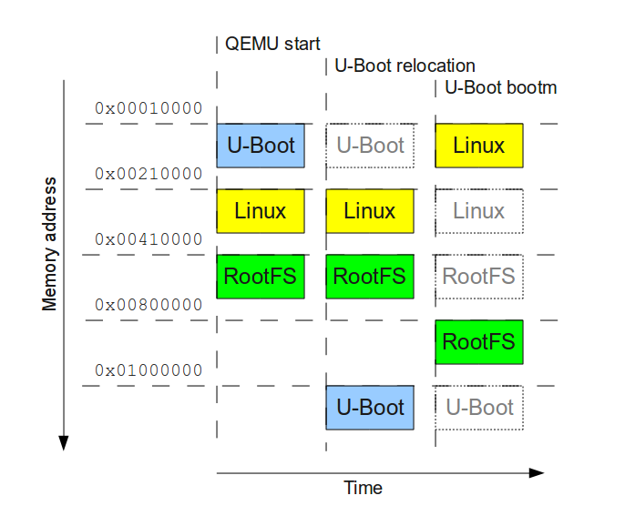
U-Boot process
Source: Balducci, Francesco.http://balau82.wordpress.com/2010/04/12/booting-linux-with-u-boot-on-qemu-arm/

Slide 24
U-boot exercise on a Versatile PB
Run the following in ~/projects/uboot-exercise:
qemu-system-arm -M versatilepb -m 128M -kernel flash.bin -serial stdio
flash.bin contains:
U-boot binary (at 0x10000 in image)
a root filesystem (at 0x210000 in image)
the linux kernel (at 0x410000 in image)
U-boot has bootm <address> to boot code
Source: Balducci, Francesco.http://balau82.wordpress.com/2010/04/12/booting-linux-with-u-boot-on-qemu-arm/

Slide 25
U-boot exercise
U-boot was patched in earlier example b/c it did not support ramdisk usage with bootm command. Good ‘nough for simulation.
U-boot uses bootm <kernel address> <rootfs image address> to boot
U-boot relocates itself to specific address (0x1000000) before loading kernel.
Source: Balducci, Francesco.http://balau82.wordpress.com/2010/04/12/booting-linux-with-u-boot-on-qemu-arm/
Notes:
Why does it relocate itself? Generally U-boot is in ROM, and so if it were to execute from flash memory, it would need to read itself from memory and execute itself in flash memory and update the image itself in flash.

Slide 26
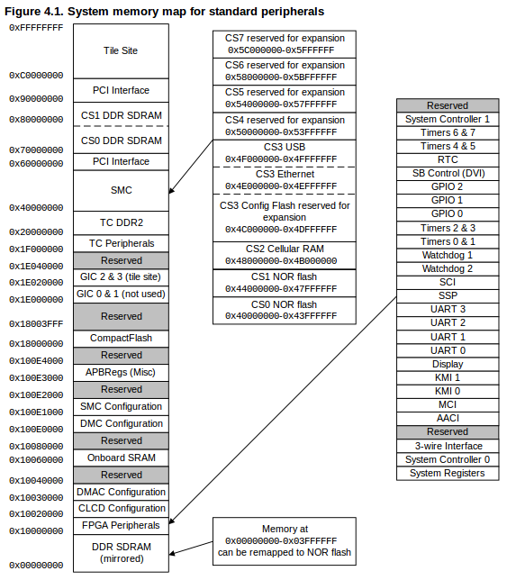
PBX w/ Cortex-A9 Memory Map
Source: http://infocenter.arm.com/help/index.jsp?topic=/com.arm.doc.dui0440b/Bbajihec.html
Notes:
Source: http://infocenter.arm.com/help/index.jsp?topic=/com.arm.doc.dui0440b/Bbajihec.html

Slide 27
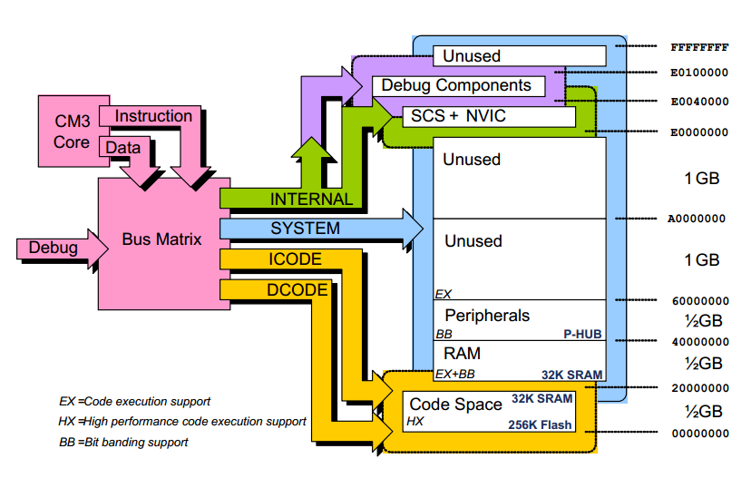
Cortex M3 Memory Map
Source: http://www.joral.ca/blog/wp-content/uploads/2009/10/CortexPrimer.pdf

Slide 28
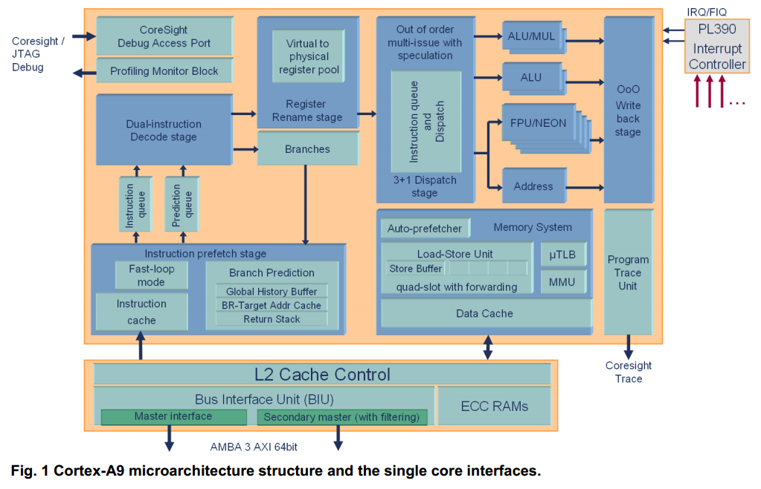
ARM Architecture
Source: http://www.arm.com/files/pdf/armcortexa-9processors.pdf
Notes:
Source: http://www.arm.com/files/pdf/armcortexa-9processors.pdf

Slide 29
Instruction cycle
Start
Fetch – fetch next instruction from memory
Execute – execute fetched instruction
Decode – decode fetched instruction
End

Slide 30
Behavior of the PC/R15
PC – Program counter (like the x86 EIP) has the address of next instruction to execute
When executing an ARM instruction, PC reads as the address of current instruction + 8
When executing a Thumb instruction, PC reads as the address of current instruction + 4
When PC is written to, it causes a branch to the written address
Thumb instructions cannot access/modify PC directly

Slide 31
That means…
00008380 <add>:
8380: b480 push {r7}
8382: b083 sub sp, #12
8384: af00 add r7, sp, #0
8386: 6078 str r0, [r7, #4]
8388: 6039 str r1, [r7, #0]
838a: 687a ldr r2, [r7, #4]
838c: 683b ldr r3, [r7, #0]
838e: 18d3 adds r3, r2, r3
8390: 4618 mov r0, r3
8392: f107 070c add.w r7, r7, #12
8396: 46bd mov sp, r7
8398: bc80 pop {r7}
839a: 4770 bx lr
When executing instruction @ x8382
PC=0x00008386

Slide 32
ARM Assembly and some conventions
Now uses Unified Assembly Language (combines ARM & Thumb instruction sets and code allowed to have intermixed instructions)
General form (there are exceptions to this):
<Instruction><Conditional>{S bit} <destination> <source> <Shift/ operand/immediate value>
Load/Store architecture means instructions only operate on registers, NOT memory
Most of the instructions expect destination first followed by source, but not all…
Notes:
Why Thumb instruction are used vs ARM?

Slide 33
ARM Assembly and some conventions contd…
<dst> will be destination register
<src> will be source register
<reg> will be any specified register
<imm> will be immediate value
<reg|cxfz..> whatever follows ‘|’ means with the specified flag enabled

Slide 34
Conditional Flags
Indicate information about the result of an operation
N – Negative result received from ALU (Bit 31 of the result if it is two’s complement signed integer)
Z – Zero flag (1 if result is zero)
C – Carry generated by ALU
V – oVerflow generated by ALU (1 means overflow)
Q –oVerflow or saturation generated by ALU (Sticky flag; set until CPSR is overwritten manually)
Flags are in a special register called CPSR (Current Program Status Register)
Flags are not updated unless used with a suffix of S on instruction

Slide 35
Current/Application Program Status Register (CPSR/APSR)
31
N
30
Z
29
C
27
28
1
26
25
24
23
22
21
20
19
18
17
16
15
14
13
12
11
10
9
8
7
6
5
4
3
2
0
V
Q
E
D
O
M
_
T
F
I
A
E
N – Negative flag
Z – Zero flag
C – Carry flag
V – Overflow flag
Q – Sticky overflow
I – 1: Disable IRQ mode
F – 1: Disable FIQ mode
T – 0: ARM state
1: Thumb state
_MODE – Mode bits

Slide 36
Push and Pop operations
PUSH <reg list> - decrements the SP and stores the value in <reg list> at that location
POP <reg list> - Stores the value at SP into <reg list> and increments the SP
Both operations only operate on SP

Slide 37
PUSH operation
INSTRUCTION: push {r7, lr}
0x7EFFF950
0x00008010
0x7EFFF954
0x0A0B0C0D
0x0A0B0C0D
0x7EFFF958
0x0a012454
0x0a012454
0x0a012454
0x7EFFF95C
0x00008350
0x00008350
0x00008350
SP
0x7EFFF958
0x7EFFF954
0x7EFFF950
R7
0x0A0B0C0D
0x0A0B0C0D
0x0A0B0C0D
LR
0x00008010
0x00008010
0x00008010

Slide 38
Arithmetic operations
ADD: add
<dst> = <src> + <imm> or <src> + <reg>
ADC: add with carry
<dst> = <src|c> + <imm> or <src|c> + <reg>
SUB: subtract
<dst> = <src> - <imm> or <src> - <reg>
SBC: subtract with carry
<dst> = <src|c> - <imm> or <src|c> - <reg>
RSB: reverse subtract
<dst> = <imm> - <src> or <reg> - <src>
RSC: reverse subtract with carry
<dst> = <imm|!c> - <src> or <reg|!c> - <src>
Notes:
When is RSB used?

Slide 39
Closer look at Example 1.c
00008354 <main>:
8354: b580 push {r7, lr}
8356: b084 sub sp, #16
8358: af00 add r7, sp, #0
835a: f04f 030a mov.w r3, #10
835e: 607b str r3, [r7, #4]
8360: f04f 030c mov.w r3, #12
8364: 60bb str r3, [r7, #8]
8366: 6878 ldr r0, [r7, #4]
8368: 68b9 ldr r1, [r7, #8]
836a: f000 f809 bl 8380 <add>
836e: 60f8 str r0, [r7, #12]
8370: f04f 0300 mov.w r3, #0
8374: 4618 mov r0, r3
8376: f107 0710 add.w r7, r7, #16
837a: 46bd mov sp, r7
837c: bd80 pop {r7, pc}
837e: bf00 nop
00008380 <add>:
8380: b480 push {r7}
8382: b083 sub sp, #12
8384: af00 add r7, sp, #0
8386: 6078 str r0, [r7, #4]
8388: 6039 str r1, [r7, #0]
838a: 687a ldr r2, [r7, #4]
838c: 683b ldr r3, [r7, #0]
838e: 18d3 adds r3, r2, r3
8390: 4618 mov r0, r3
8392: f107 070c add.w r7, r7, #12
8396: 46bd mov sp, r7
8398: bc80 pop {r7}
839a: 4770 bx lr
int main(void) {
int a, b, c;
a=10;
b=12;
c=add(a,b);
return 0;
}
int add(int a, int b)
{
return a+b;
}
The highlighted instruction is a special form of SUB. In this case means:
SP = SP - 16
Thumb instructions are intermixed with ARM instructions.

Slide 40
SBC & RSB operations
INSTRUCTION: sbc r0, r0, r1 rsb r0, r0, r1
MEANS : r0 = r0 – r1 – NOT(C) r0 = r1 – r0 (No flags updated)
R0
0xF5F4F3FD
0x0A0B0C03
R1
0x0A0B0C0D
0x0A0B0C0D
After Operation
CPSR
0x20000010
0x20000010
R0
0x0000000A
0x0000000A
Before Operation
R1
0x0A0B0C0D
0x0A0B0C0D
CPSR
0x20000010
0x20000010

Slide 41
Arithmetic operations part 2
MUL: <dst> = <reg1> * <reg2>
MLA: <dst> = (<reg1> * <reg2>) + <reg3>
MLA{S}{<c>} <Rd>, <Rn>, <Rm>, <Ra> where <Rd> is destination register, <Rn> & <Rm> are the first and second operands respectively and <Ra> is the addend register
MLS: <dst> = <reg3> - (<reg1> * <reg2>)
Multiply operations only store least significant 32 bits of result into destination
Result is not dependent on whether the source register values are signed or unsigned values

Slide 42
example2.c
int main(void) {
int a, b, c, d;
a=2;
b=3;
c=4;
d = multiply(a,b);
printf(“a * b is %d\n”, d);
d = multiplyadd(a,b,c);
printf(“a * b + c is %d\n”, d);
return 0;
}
int multiply(int a, int b)
{
return (a*b);
}
Int multiplyadd(int a, int b, int c)
{
return ((a*b)+c);
}
000083b8 <multiply>:
83b8: fb01 f000 mul.w r0, r1, r0
83bc: 4770 bx lr
83be: bf00 nop
000083c0 <multiplyadd>:
83c0: fb01 2000 mla r0, r1, r0, r2
83c4: 4770 bx lr
83c6: bf00 nop

Slide 43
MLA & MLS operations
INSTRUCTION: mla r0, r0, r1, r2 mls r0, r0, r1, r2
MEANS : r0 = r0 * r1 + r2 r0 = r2 – (r0 * r1) (No flags updated)
R0
0x0000008F
0xFFFFFF77
R1
0x0000000E
0x0000000E
After Operation
R2
0x00000003
0x00000003
CPSR
0x20000010
0x20000010
R0
0x0000000A
0x0000000A
R1
0x0000000E
0x0000000E
Before Operation
R2
0x00000003
0x00000003
CPSR
0x20000010
0x20000010

Slide 44
Arithmetic operations part 3
PLEASE NOTE: These instructions are only available on Cortex-R profile
SDIV – Signed divide
UDIV – Unsigned divide
On the Cortex-A profile there is no divide operation

Slide 45
Example x.s
000083e4 <divide>:
83e4: e710f110 sdiv r0, r0, r1
83e8: e12fff1e bx lr
83ec: e1a00000 nop ; (mov r0, r0)
000083f0 <unsigneddivide>:
83f0: e730f110 udiv r0, r0, r1
83f4: e12fff1e bx lr
83f8: e1a00000 nop ; (mov r0, r0)

Slide 46
Using the emulator
cd ~/projects/linaro
./startsim
Password is passw0rd
To copy <localfile> to </path/to/file> on emulator:
scp –P 2200 <localfile> root@localhost:</path/to/file>
To copy </path/to/file> from emulator to <localfile>:
scp –P 2200 root@localhost:</path/to/file> <localfile>

Slide 47
objdump introduction
dumps the objects in an ELF (Executable Linkable Format) file.
objects that are in a form before they are linked
-g gdb option for gcc adds debug symbols that objdump can read
-d option for objdump used for dissassembling (get assembly code from the ELF format)

Slide 48
objdump usage
helloworld.c
objdump –d helloworld | less
int main(void) {
printf(“Hello world!\n”);
return 0;
}

Slide 49
Try dividing now on the emulator
Goto ~/projects/examples
Copy example1 to divexample
Replace the add () function in example1.c with divide and return (a/b)
Run make clobber && make
Disassemble…
objdump –d example1 | less
What do you see?

Slide 50
NOP Instruction
A most interesting instruction considering it does nothing
ARM Reference Manual mentions that this instruction does not relate to code execution time (It can increase, decrease or leave the execution time unchanged). Why?
Primary purpose is for instruction alignment. (ARM and Thumb instructions together… What could go wrong?)
Can also be used as part of vector tables
In some microcontrollers, it is also used for synchronization of pipeline.

Slide 51
Barrel Shifter
Hardware optimization inline with the ALU allows for a multiplier (power of 2) within same instruction cycle
Allows for shifting a register value by either an unsigned integer (MAXVAL of 32) or a value specified in bottom byte of another register.
ASR – Arithmetic Shift Right (MSB copied at left, last bit off right is Carry)
LSL – Logical Shift Left (0s at right, last bit off left is Carry)
MOV R7, R5, LSL #2 means (R7=R5*4) or (R5<<2)
ADD R0, R1, R1, LSL #1 means R0=R1+(R1<<1)
LSR – Logical Shift Right (0s at left, last bit off right is Carry)
ROR – Rotate Right (bits popped off the right end, is directly pushed into left, last bit off right is Carry)
RRX – Rotate Right with Extend (bits popped off the right end first go into Carry, Carry is shifted in to left, last bit off right is Carry)
Notes:
LSL – introduce 0s at right, last bit off of left is carry bit
LSR – introduce 0s at left, last bit off of right is carry bit
ROR – bits from right end is pushed into left end, last bit off of right is carry bit
RRX – bits from right end first go into carry then pushed into left end, last bit off of right is carry bit

Slide 52
Hints on how to RTFM
{S} – updates flags in the CPSR
{<c>} – allows mnemonic of conditional to be added
{<q>} – instruction suffix with either:
.N Narrow, assembler must use 16-bit encoding for the intruction
.W Wide, assembler must use 32-bit encoding for the instruction
Do not use the .N or .W in your assembly code.
As per manual, it will throw errors. GNU Assembler decides on encoding depending on options selected.

Slide 53
Example 3.1.c
int main(void)
{
int a, b, d;
a = 6;
b = 8;
d = multiplybytwo(a) * multiplybytwo(b);
printf("2a * 2b is %d\n", d);
return 0;
}
int multiplybytwo(int a)
{
return a*2;
}
00008318 <main>:
8318: b508 push {r3, lr}
831a: 2001 movs r0, #1
831c: 22c0 movs r2, #192 ; 0xc0
831e: f248 4100 movw r1, #33792 ; 0x8400
8322: f2c0 0100 movt r1, #0
8326: f7ff efec blx 8300 <_init+0x3c>
832a: 2000 movs r0, #0
832c: bd08 pop {r3, pc}
832e: bf00 nop
000083a8 <multiplybytwo>:
83a8: 0040 lsls r0, r0, #1
83aa: 4770 bx lr

Slide 54
Example 3.2.c
int main(void)
{
int a, b, d;
a = -6;
b = 8;
d = dividebytwo(a) / dividebytwo(b);
printf("a/2 / b/2 is %d\n", d);
return 0;
}
int dividebytwo(int a)
{
return a/2;
}
00008318 <main>:
8318: b508 push {r3, lr}
831a: 2001 movs r0, #1
831c: 2200 movs r2, #0
831e: f248 4104 movw r1, #33796 ; 0x8404
8322: f2c0 0100 movt r1, #0
8326: f7ff efec blx 8300 <_init+0x3c>
832a: 2000 movs r0, #0
832c: bd08 pop {r3, pc}
832e: bf00 nop
000083a8 <dividebytwo>:
83a8: eb00 70d0 add.w r0, r0, r0, lsr #31
83ac: 1040 asrs r0, r0, #1
83ae: 4770 bx lr

Slide 55
Example 3.2.c
add.w r0, r0, r0, lsr #31
asrs r0, r0, #1
R0
0xFFFFFFF9
R0
0xFFFFFFFC
R1
0x0000000E
R1
0x0000000E
R2
0x00000003
R2
0x00000003
CPSR
0xA0000010
CPSR
0xA0000010
R0
0xFFFFFFF8
R0
0x00001000
R1
0x0000000E
R1
0x0000000E
R2
0x00000003
R2
0x00000003
CPSR
0x20000010
CPSR
0x20000010

Slide 56
RRX & LSL operation
INSTRUCTION: mvn r0, r0, RRX add r0, r0, r1, LSL #4
MEANS : r0 = ~r0 >> 1 r0 = r0 + (r1 * 16) (No flags updated)
R0
0xFFFFFFFA
0x000000EA
R1
0x0000000E
0x0000000E
R2
0x00000003
0x00000003
CPSR
0xA0000010
0x20000010
R0
0x0000000A
0x0000000A
R1
0x0000000E
0x0000000E
R2
0x00000003
0x00000003
CPSR
0x20000010
0x20000010

Slide 57
More Data operations
MOV – move value from one register to another
Combine with postfixes to modify:
MOVT: Moves only top half word into destination without changing lower half word
MOVS PC,<reg>: Moves value into destination register and updates CPSR flags
MVN – Bitwise NOT of value into destination register
Cannot be used on memory locations

Slide 58
Example 4.c
int main(void)
{
int a, b, d;
a = 221412523;
b = 3;
d = multiply(a,b);
printf("a * b is %d\n", d);
return 0;
}
int multiply(int a, int b)
{
return (a*b);
}
00008318 <main>:
8318: b508 push {r3, lr}
831a: 2001 movs r0, #1
831c: f248 4108 movw r1, #33800 ; 0x8408
8320: f247 6201 movw r2, #30209 ; 0x7601
8324: f2c0 0100 movt r1, #0
8328: f2c2 7297 movt r2, #10135 ; 0x2797
832c: f7ff efe8 blx 8300 <_init+0x3c>
8330: 2000 movs r0, #0
8332: bd08 pop {r3, pc}
000083ac <multiply>:
83ac: fb01 f000 mul.w r0, r1, r0
83b0: 4770 bx lr
83b2: bf00 nop
221412523*3 = 664237569 or 0x27977601

Slide 59
Example 6.c
int main(void)
{
int a, b;
a = 6;
. . .
// Important: Subtraction taking place
b = a - 182947;
. . .
printf("a's negatory is %d\n", b);
return 0;
}
0000838c <main>:
838c: b590 push {r4, r7, lr}
838e: b085 sub sp, #20
8390: af00 add r7, sp, #0
8392: f04f 0306 mov.w r3, #6
8396: 60fb str r3, [r7, #12]
8398: f3ef 8400 mrs r4, CPSR
839c: 60bc str r4, [r7, #8]
839e: 68fa ldr r2, [r7, #12]
83a0: f243 535d movw r3, #13661 ; 0x355d
83a4: f6cf 73fd movt r3, #65533 ; 0xfffd
83a8: 18d3 adds r3, r2, r3
83aa: 607b str r3, [r7, #4]
83ac: f3ef 8400 mrs r4, CPSR
83b0: 603c str r4, [r7, #0]
83b2: f248 4344 movw r3, #33860 ; 0x8444
83b6: f2c0 0300 movt r3, #0
83ba: 4618 mov r0, r3
83bc: 6879 ldr r1, [r7, #4]
...
Before the subtraction operation
CPSR = 0x60000010
After the subtraction operation
CPSR = 0x80000010

Slide 60
Reversing byte order
REV – reverses byte order (& endianness) of value in register and stores into destination register
REV16 – reverses byte order of each 16-bit halfword in register and stores into destination register
REVSH – reverses byte order of lower 16-bit halfword in register, sign extends to 32 bits and store into destination register

Slide 61
REV & REV16 operations
INSTRUCTION: rev r0, r0 rev16 r0, r0
R0
0xFFDECDAB
0xCDABFFDE
CPSR
0x20000010
0x20000010
R0
0xABCDDEFF
0xABCDDEFF
CPSR
0x20000010
0x20000010

Slide 62
Current Program Status Register
31
N
30
Z
29
C
27
28
1
26
25
24
23
22
21
20
19
18
17
16
15
14
13
12
11
10
9
8
7
6
5
4
3
2
0
V
Q
E
D
O
M
_
T
F
I
A
E
N – Negative flag
Z – Zero flag
C – Carry flag
V – Overflow flag
Q – Sticky overflow
I – 1: Disable IRQ mode
F – 1: Disable FIQ mode
T – 0: ARM state
1: Thumb state
_MODE – Mode bits

Slide 63
Logical & Comparison operations
AND – Bitwise AND
BIC – Bitwise bit clear
EOR – Bitwise Exclusive OR
ORR – Bitwise OR
ORN – Bitwise OR NOT
CMP – Compare. SUB but with NO destination. (Same as SUBS)
CMN – Compare Negative. ADD but with NO destination. (Same as ADDS)
TEQ – Test Equivalence. Like EOR but with NO destination.
TST – Test. Like AND but with NO destination.

Slide 64
Example 7.1.c
int main(void)
{
int a, b, d;
a = 221412523;
b = 374719560;
d = and(a,b);
printf("a & b is %d\n", d);
return 0;
}
int and(int a, int b)
{
return (a&b);
}
000083d0 <and>:
83d0: 4008 ands r0, r1
83d2: 4770 bx

Slide 65
Example 7.2.c
int main(void)
{
int a, b, d;
a = 221412523;
b = 374719560;
d = orr(a,b);
printf("a | b is %d\n", d);
return 0;
}
int orr(int a, int b)
{
return (a|b);
}
000083d0 <orr>:
83d0: 4308 orrs r0, r1
83d2: 4770 bx lr

Slide 66
Example 7.3.c
0000838c <main>:
<prolog> ...
8392: f04f 0308 mov.w r3, #8
8396: 60bb str r3, [r7, #8]
8398: f04f 0309 mov.w r3, #9
839c: 607b str r3, [r7, #4]
839e: f3ef 8400 mrs r4, CPSR
83a2: 603c str r4, [r7, #0]
83a4: 68ba ldr r2, [r7, #8]
83a6: 687b ldr r3, [r7, #4]
83a8: 4053 eors r3, r2
83aa: 2b00 cmp r3, #0
83ac: dd05 ble.n 83ba <main+0x2e>
83ae: 68b8 ldr r0, [r7, #8]
83b0: 6879 ldr r1, [r7, #4]
83b2: f000 f829 bl 8408 <add>
83b6: 60f8 str r0, [r7, #12]
83b8: e004 b.n 83c4 <main+0x38>
83ba: 6878 ldr r0, [r7, #4]
83bc: 68b9 ldr r1, [r7, #8]
83be: f000 f831 bl 8424 <subtract>
83c2: 60f8 str r0, [r7, #12]
<contd>...
int main(void)
{
int a, b, d;
a = 8;
b = 9;
if((a ^ b) > 0)
d = add(a,b);
else
d = subtract(b,a);
printf("a & b is %d\n", d);
return 0;
}
int add(int a, int b)
{
return (a+b);
}
int subtract(int a, int b)
{
return (a-b);
}
Notes:
-O0

Slide 67
BIC
BIC clears the bits specified in a mask
For example,
R0 = 0x57 or 0b0101 0111
R1 = 0x24 or 0b0010 0100
BIC <R2> <R0> <R1>
Means R2 = R0 & ~(R1) = 0b0101 0011 or 0x53
Mask can also be a shifted value (using Shift operations)

Slide 68
Memory operations Part I
LDR – Load data from memory into registers
STR – Store data from registers to memory
Caveat: LDR/STR can load/store data on a boundary alignment that is the same as the data type size being loaded/stored.
LDR can only load 32-bit words on a memory address that is multiples of 4 bytes.

Slide 69
Memory Operations Part I contd…
LDR r0, [r1] loads r0 with contents of memory address pointed to by r1
STR r0, [r1] stores the contents of r0 to the memory address pointed to by r1.
Warning: This can be confusing since destination is actually specified in the second argument
Also LDR r0, [r1, #4] means
r0 = [r1 + 4] and r1 value remains unchanged
Similarly STR r0, [r1, #4] means
[r1+4] = r0 and r1 value remains unchanged
The above two instructions addressing mode is called pre-indexed addressing

Slide 70
Example 8.c
0000838c <main>:
838c: b580 push {r7, lr}
838e: b084 sub sp, #16
8390: af00 add r7, sp, #0
8392: f04f 0308 mov.w r3, #8
8396: 607b str r3, [r7, #4]
8398: f04f 0309 mov.w r3, #9
839c: 60fb str r3, [r7, #12]
839e: f107 0304 add.w r3, r7, #4
83a2: 60bb str r3, [r7, #8]
83a4: 68bb ldr r3, [r7, #8]
83a6: 681b ldr r3, [r3, #0]
83a8: f103 0302 add.w r3, r3, #2
83ac: 60fb str r3, [r7, #12]
83ae: f248 4330 movw r3, #33840 ; 0x8430
83b2: f2c0 0300 movt r3, #0
83b6: 4618 mov r0, r3
83b8: 68b9 ldr r1, [r7, #8]
83ba: f7ff ef92 blx 82e0 <_init+0x20>
83be: f248 434c movw r3, #33868 ; 0x844c
83c2: f2c0 0300 movt r3, #0
83c6: 4618 mov r0, r3
83c8: 68f9 ldr r1, [r7, #12]
83ca: f7ff ef8a blx 82e0 <_init+0x20>
83ce: f04f 0300 mov.w r3, #0
83d2: 4618 mov r0, r3
83d4: f107 0710 add.w r7, r7, #16
83d8: 46bd mov sp, r7
83da: bd80 pop {r7, pc}
int main(void)
{
int a, b;
int *x;
a = 8;
b = 9;
x = &a;
b = *x + 2;
printf("The address of a is 0x%x\n",x);
printf("The value of b is now %d\n",b);
return 0;
}
Notes:
-O0 optimization

Slide 71
Memory operations Part I contd…
R7 in the previous example is known as base address register, where the base address register can by any one of R0-R12, SP, or LR
We will cover consecutive multiple loads in one instruction later

Slide 72
Control Flow operations (Table A4-1)
Instruction | Description | Thumb mode range | ARM mode range
B <label> | Branch to target address | +/- 16 MB | +/- 32 MB
BL, BLX <imm> | Call a subroutine Call a subroutine, change instruction set | +/- 16 MB | +/- 32 MB
BLX <reg> | Call a subroutine, optionally change instruction set | Any | Any
BX | Branch to target address, change instruction set | Any | Any
CBZ | Compare and Branch on Zero | 0-126 bytes | Does not exist
CBNZ | Compare and Branch on Nonzero | 0-126 bytes | Does not exist
TBB | Table Branch (byte offsets) | 0-510 bytes | Does not exist
TBH | Table Branch (halfword offsets) | 0-131070 bytes | Does not exist

Slide 73
Conditional Branching
BLE: Branch if less than or equal
Z=1 OR N!=V
BGT: Branch if greater than
Z=0 AND N=V
BEQ: Branch if equal
Z=1
BNE: Branch if not equal
Z=0
How do N and V flags tell us if something is less or greater than?
Generally there is a CMP or TST instruction before
CMP <r0> <r1> means perform <r0> - <r1>

Slide 74
Example 9.s
0000835c <__libc_csu_init>:
835c: e92d 43f8 stmdb sp!, {r3, r4, r5, r6, r7, r8, r9, lr}
8360: 4606 mov r6, r0
8362: f8df 9034 ldr.w r9, [pc, #52] ; 8398 <__libc_csu_init+0x3c>
8366: 460f mov r7, r1
8368: 4d0c ldr r5, [pc, #48] ; (839c <__libc_csu_init+0x40>)
836a: 4690 mov r8, r2
836c: 44f9 add r9, pc
836e: f7ff ff91 bl 8294 <_init>
8372: 447d add r5, pc
8374: ebc5 0909 rsb r9, r5, r9
8378: ea5f 09a9 movs.w r9, r9, asr #2
837c: d009 beq.n 8392 <__libc_csu_init+0x36>
837e: 2400 movs r4, #0
8380: f855 3b04 ldr.w r3, [r5], #4
8384: 4630 mov r0, r6
8386: 4639 mov r1, r7
8388: 4642 mov r2, r8
838a: 3401 adds r4, #1
838c: 4798 blx r3
838e: 454c cmp r4, r9
8390: d1f6 bne.n 8380 <__libc_csu_init+0x24>
8392: e8bd 83f8 ldmia.w sp!, {r3, r4, r5, r6, r7, r8, r9, pc}
8396: bf00 nop
8398: 00008ba0 .word 0x00008ba0
839c: 00008b96 .word 0x00008b96

Slide 75
Current Program Status Register
31
N
30
Z
29
C
27
28
1
26
25
24
23
22
21
20
19
18
17
16
15
14
13
12
11
10
9
8
7
6
5
4
3
2
0
V
Q
E
D
O
M
_
T
F
I
A
E
N – Negative flag
Z – Zero flag
C – Carry flag
V – Overflow flag
Q – Sticky overflow
I – 1: Disable IRQ mode
F – 1: Disable FIQ mode
T – 0: ARM state
1: Thumb state
_MODE – Mode bits

Slide 76
Hello, World! in ARM Assembly
.text
_start: .global _start
@ sys_write ( fd, pstr, len )
@ r7=4 r0 r1 r2
mov r0, #1 @ fd <- stdout
adr r1, msg @ pstr <- *msg
mov r2, #14 @ len <- 14
mov r7, #4 @ syscall <- sys_write
swi 0 @ system call
@ sys_exit ( exitcode )
@ r7=1 r0
mov r0, #0 @ exitcode <- 0
mov r7, #1 @ syscall <- sys_exit
swi 0 @ system call
msg:
.asciz "Hello, world!\n"
.end
Linux GNUEABI spec means syscall identifier is put in R7 and arguments in R0-R6
Linux kernel ignores #imm value after SWI instruction
Syscall invoked with SWI/SVC instruction (supervisor mode)
Source: http://peterdn.com/post/e28098Hello-World!e28099-in-ARM-assembly.aspx

Slide 77
Instructions covered so far…
NOP
ADD, ADC, SUB, SBC, RSB, RSC
ASR, LSL, LSR, ROR, RRX
MOV, MVN
REV, REVSH, REV16
AND, EOR, ORR, ORN, CMP, CMN
BIC, TEQ, TST
B, BL, BLX, BLE, BGT
SWI

Slide 78
Hints on how to RTFM
{S} – updates flags in the CPSR
{<c>} – allows mnemonic of conditional to be added
{<q>} – instruction suffix with either:
.N Narrow, assembler must use 16-bit encoding for the intruction
.W Wide, assembler must use 32-bit encoding for the instruction
Do not use the .N or .W in your assembly code.
As per manual, it will throw errors. Assembler decides on encoding depending on options selected.

Slide 79
Lab 1
Again commands given below for copying files into and out of the simulator
scp –P 2200 <localfile> root@localhost:/path/to/file
scp –P 2200 root@localhost:/path/to/file <localfile>
Password is passw0rd
Fibonacci program
Write assembly function to calculate fibonacci value at a given position x
R0 has x
For example: [0, 1, 2, 3, 4, 5, 6 …] x
[0, 1, 1, 2, 3, 5, 8 …] fibonacci(x)
Only modify fib.s

Slide 80
Sample algorithms
// Non-recursive
int fibonacci(int x) {
int previous = -1;
int result = 1;
int i=0;
int sum=0;
for (i = 0; i <= x; i++) {
sum = result + previous;
previous = result;
result = sum;
}
return result;
}
// Recursive
int fibonacci(int x) {
if(x<=0) return 0;
if(x==1) return 1;
return fibN(x-1) + fibN(x-2);
}
NOTE: Filler code follows Recursive algorithm.

Slide 81
Possible solution
fibonacci:
push {r3, r4, r5, lr} ; function prolog
subs r4, r0, #0 ; r4 = r0 - 0
ble .L3 ; if (r0 <= 0) goto .L3
cmp r4, #1 ; Compare r4 to 1
beq .L4 ; if (r4 == 1) goto .L4
add r0, r4, #4294967295 ; r0 = r4 + 4294967295 (or #0xFFFFFFFF)
bl fibonacci ; goto fibonacci @PC relative address
mov r5, r0 ; r5 = r0
sub r0, r4, #2 ; r0 = r4 - 2
bl fibonacci ; goto fibonacci @PC relative address
adds r0, r5, r0
pop {r3, r4, r5, pc}
.L3:
mov r0, #0
pop {r3, r4, r5, pc}
.L4:
mov r0, #1
pop {r3, r4, r5, pc}

Slide 82
Day 1 Part 2

Slide 83
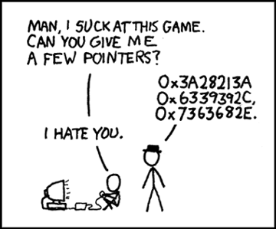
Ah the old joke…
Source: http://xkcd.com/138/

Slide 84
Memory operations Part I reminder…
LDR r0, [r1]
R1 in this example is known as base address register, where the base address register can be any one of R0-R12, SP, or LR

Slide 85
Memory Operations Part II: Indexing operations
Preindex with Writeback (denoted by [Rn,offset]!)
Calculates address in base register + offset
Uses calculated address for operation into Rn
Stores the calculated address into base register
Preindex (denoted by [Rn,offset])
Calculates address in base register + offset
Uses calculated address for operation into Rn
Does NOT store the calculated address into base register
Postindex (denoted by [Rt])
Uses address in base register for operation into Rn
Calculates address in base register + offset
Stores the calculated address into base register
Notes:
offset(immediate/register/shifted value)

Slide 86
LDR Indexing
Indexing mode | Instruction | R0 | R1 or Rbase
Preindex with Writeback | LDR r0, [r1, #2]! | r0 = [r1 + 2] | r1 = r1 + 2
 | LDR r0, [r1, r2]! | r0 = [r1 + r2] | r1 = r1 + r2
 | LDR r0, [r1, r2, LSL #3]! | r0 = [r1 + (r2 LSL 3)] | r1 = r1 + (r2 LSL 3)
Preindex | LDR r0, [r1, #2] | r0 = [r1 + 2] | r1 = r1
 | LDR r0, [r1, r2] | r0 = [r1 + r2] | r1 = r1
 | LDR r0, [r1, r2, LSL #3] | r0 = [r1 + (r2 LSL 3)] | r1 = r1
Postindex | LDR r0, [r1], #2 | r0 = [r1] | r1 = r1 + 2
 | LDR r0, [r1], r2 | r0 = [r1] | r1 = r1 + r2
 | LDR r0, [r1], r2, LSL #3 | r0 = [r1] | r1 = r1 + (r2 LSL 3)
Instruction form: LDR<c> <Rt>, [<Rn>{, offset}] where [] denotes memory contents of
Source: http://www.slideshare.net/guest56d1b781/arm-fundamentals

Slide 87
STR indexing
Indexing mode | Instruction | Rt | Rn or Rbase
Preindex with Writeback | STR r0, [r1, #2]! | [r1 + 2] = r0 | r1 = r1 + 2
 | STR r0, [r1, r2]! | [r1 + r2] = r0 | r1 = r1 + r2
 | STR r0, [r1, r2, LSL #3]! | [r1 + (r2 LSL 3)] = r0 | r1 = r1 + (r2 LSL 3)
Preindex | STR r0, [r1, #2] | [r1 + 2] = r0 | r1 = r1
 | STR r0, [r1, r2] | [r1 + r2] = r0 | r1 = r1
 | STR r0, [r1, r2, LSL #3] | [r1 + (r2 LSL 3)] = r0 | r1 = r1
Postindex | STR r0, [r1], #2 | [r1] = r0 | r1 = r1 + 2
 | STR r0, [r1], r2 | [r1] = r0 | r1 = r1 + r2
 | STR r0, [r1], r2, LSL #3 | [r1] = r0 | r1 = r1 + (r2 LSL 3)
Instruction form: STR<c> <Rt>, [<Rn>{, offset}] where [] denotes memory contents of
Source: http://www.slideshare.net/guest56d1b781/arm-fundamentals
Notes:
Source: http://www.slideshare.net/guest56d1b781/arm-fundamentals

Slide 88
Example 10 (Any program)
00008318 <main>:
8318: b508 push {r3, lr}
831a: 2001 movs r0, #1
831c: f248 4108 movw r1, #33800 ; 0x8408
8320: f247 6201 movw r2, #30209 ; 0x7601
8324: f2c0 0100 movt r1, #0
8328: f2c2 7297 movt r2, #10135 ; 0x2797
832c: f7ff efe8 blx 8300 <_init+0x3c>
8330: 2000 movs r0, #0
8332: bd08 pop {r3, pc}
00008334 <_start>:
8334: f04f 0b00 mov.w fp, #0
8338: f04f 0e00 mov.w lr, #0
833c: f85d 1b04 ldr.w r1, [sp], #4
8340: 466a mov r2, sp
8342: f84d 2d04 str.w r2, [sp, #-4]!
8346: f84d 0d04 str.w r0, [sp, #-4]!
834a: f8df c014 ldr.w ip, [pc, #20] ; 8360 <_start+0x2c>
834e: f84d cd04 str.w ip, [sp, #-4]!
8352: 4804 ldr r0, [pc, #16] ; (8364 <_start+0x30>)
8354: 4b04 ldr r3, [pc, #16] ; (8368 <_start+0x34>)
8356: f7ff efc6 blx 82e4 <_init+0x20>
835a: f7ff efd8 blx 830c <_init+0x48>
835e: 0000 .short 0x0000
8360: 000083f9 .word 0x000083f9
8364: 00008319 .word 0x00008319
8368: 000083b5 .word 0x000083b5

Slide 89
A note on LDR/STR
For loading large constants into registers, the assembler generally prefers using MOVN <Rd>, <#~large constant> (~ is Bitwise NOT)
Assembler likes to use values between 0 and 255 along with barrel shifts to arrive at value
Example:
Instead of:
LDR R0, #ffffff23
MOVN R0, #0xDC

Slide 90
Other Instructions
SSAT <reg1> <imm> <reg2> – Signed Saturate
USAT <reg1> <imm> <reg2> – Unsigned Saturate
QADD <reg1> <reg2> <reg3> – Add & saturate the result (<reg1> = sat(<reg2> + <reg3>)
QSUB –Subtract & saturate the result
<reg1> = sat(<reg2> - <reg3>)
QDADD – Saturate Double & Add <reg1>=sat(<reg2> + 2*<reg3>)
QDSUB – <reg1> = sat(<reg2> - 2*<reg3>)

Slide 91
Control Flow operations (Table A4-1)
Instruction | Description | Thumb mode range | ARM mode range
B <label> | Branch to target address | +/- 16 MB | +/- 32 MB
BL, BLX <imm> | Call a subroutine Call a subroutine, change instruction set | +/- 16 MB | +/- 32 MB
BLX <reg> | Call a subroutine, optionally change instruction set | Any | Any
BX | Branch to target address, change instruction set | Any | Any
CBZ | Compare and Branch on Zero (16-bit) Permitted offsets are even from 0 – 126 | +4 to +130 bytes | Does not exist
CBNZ | Compare and Branch on Nonzero (16-bit) Permitted offsets are even from 0 – 126 | +4 to +130 bytes | Does not exist
TBB | Table Branch (byte offsets) (32-bit) | 0-510 bytes | Does not exist
TBH | Table Branch (halfword offsets) (32-bit) | 0-131070 bytes | Does not exist

Slide 92
Conditional execution
Most instructions can be made conditional by adding two letter mnemonic from table A8-1 to end of an existing instruction
It increases performance by reducing the # of branches
Example:
ADDEQ r0, r1, r2 ; If zero flag is set then r0=r1+r2

Slide 93
Conditional operations (Table A8-1)
Suffix | Description | Flags tested
EQ | Equal | Z=1
NE | Not Equal | Z=0
CS/HC | Unsigned higher or same | C=1
CC/LO | Unsigned lower | C=0
MI | Minus | N=1
PL | Positive or Zero | N=0
VS | Overflow | V=1
VC | No overflow | V=0
HI | Unsigned Higher | C=1 AND Z=0
LS | Unsigned lower or same | C=0 OR Z=1
GE | Greater or equal | N=V
LT | Less than | N!=V
GT | Greater than | Z=0 AND N=V
LE | Less than or equal | Z=1 OR N!=V
AL | Always

Slide 94
Current Program Status Register
31
N
30
Z
29
C
27
28
1
26
25
24
23
22
21
20
19
18
17
16
15
14
13
12
11
10
9
8
7
6
5
4
3
2
0
V
Q
E
D
O
M
_
T
F
I
A
E
N – Negative flag
Z – Zero flag
C – Carry flag
V – Overflow flag
Q – Sticky overflow
I – 1: Disable IRQ mode
F – 1: Disable FIQ mode
T – 0: ARM state
1: Thumb state
_MODE – Mode bits

Slide 95
Pipelining
Does not decrease instruction execution time
Increases throughput
Time allocated dependent on longest cycle instruction
Fetches and decodes instructions in parallel while executing current instruction.
Source: http://www-cs-faculty.stanford.edu/~eroberts/courses/soco/projects/2000-01/risc/pipelining/index.html
Also see http://www.cse.unsw.edu.au/~cs9244/06/seminars/08-leonidr.pdf

Slide 96
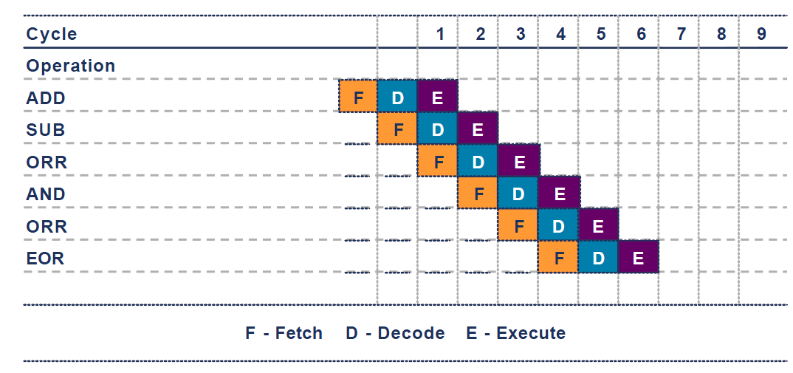
Pipelining in action
Source: http://web.eecs.umich.edu/~prabal/teaching/eecs373-f10/readings/ARM_Architecture_Overview.pdf

Slide 97
Issues associated with pipelining
Branch instructions
Conditional execution reduces number of branches, which reduces # of pipeline flushes
Instructions dependent on previous instructions (data-dependency)
Interrupts in the beginning/middle/end of cycle?
How code is optimized for pipelining is compiler & processor dependent
Source: http://bnrg.eecs.berkeley.edu/~randy/Courses/CS252.S96/Lecture08.pdf

Slide 98
Other ways of branching
LDR PC, [PC, #offset]
Value written has to be aligned for mode
Earlier processors (armv4 and earlier) used to have prefetch
PC points two instructions ahead
Programmer has to account for PC+8
Store address of branch location at current address + offset + 8
Same tradition continues for all arm architectures so far
Source: http://en.wikipedia.org/wiki/List_of_ARM_microprocessor_cores

Slide 99
Example 12.s
0x10000000 add r0, r1, r2
0x10000004 ldr pc, [pc, #4]
0x10000008 sub r1, r2, r3
0x1000000c cmp r0, r1
0x10000010 0x20000000
…
Branch target
0x20000000 str r5, [r13, -#4]!

Slide 100
ONE instruction to rule them all..
LDM/STM – Load multiple/Store multiple
Used in conjunction with a suffix (called mode) for how to move consecutively
Lowest register uses the lowest memory address

Slide 101
LDM/STM modes
Mode | Short description | LDM synonym | STM synonym | Start Address | End Address | Rn!
IA | Increment After | P=0, U=1 | P=0, U=1 | Rn | Rn+4*N-4 | Rn+4*N
IB | Increment Before | P=1, U=1 | P=1, U=1 | Rn+4 | Rn+4*N | Rn+4*N
DA | Decrement after | P=0, U=0 | P=0, U=0 | Rn-4*N+4 | Rn | Rn-4*N
DB | Decrement before | P=1, U=0 | P=1, U=0 | Rn-4*N | Rn-4 | Rn-4*N
FA | Full Ascending | DA | IB
EA | Empty Ascending | DB | IA
FD | Full Descending | IA | DB
ED | Empty Descending | IB | DA
N is the number of registers
n goes from 1..N

Slide 102
Stack operations
Instead of POP, we use Load-Multiple
Instead of PUSH, we use Store-Multiple
Stacks can be
(A)scending – stack grows to higher memory addresses
(D)escending – stack grows to lower memory addresses

Slide 103
LDM/STM pairs
Store Multiple | Load Multiple
STMIA | LDMDB
STMIB | LDMDA
STMDA | LDMIB
STMDB | LDMIA

Slide 104
STMDB operation
INSTRUCTION: STMDB sp!, {r3, r4, r5, r7}
0x8000
0x8004
R3
0xABCDDEFF
0x8008
0xABCDDEFF
R4
0x0000CAFE
0x800C
0x0000CAFE
R5
0xFEED0000
0x8010
0xFEED0000
R7
0xF00D0000
0x8014
0xF00D0000
SP
0x00008018
0x8018
SP
0x00008008

Slide 105
LDMIA operation
INSTRUCTION: LDMIA sp!, {r3, r4, r5, r7}
0x8000
0x8004
R3
0xABCDDEFF
0x8008
0xABCDDEFF
R4
0x0000CAFE
0x800C
0x0000CAFE
R5
0xFEED0000
0x8010
0xFEED0000
R7
0xF00D0000
0x8014
0xF00D0000
0x8018
SP
0x00008018
SP
0x00008008

Slide 106
Example 13.s
0000835c <__libc_csu_init>:
835c: e92d 43f8 stmdb sp!, {r3, r4, r5, r6, r7, r8, r9, lr}
8360: 4606 mov r6, r0
8362: f8df 9034 ldr.w r9, [pc, #52] ; 8398 <__libc_csu_init+0x3c>
8366: 460f mov r7, r1
8368: 4d0c ldr r5, [pc, #48] ; (839c <__libc_csu_init+0x40>)
836a: 4690 mov r8, r2
836c: 44f9 add r9, pc
836e: f7ff ff91 bl 8294 <_init>
8372: 447d add r5, pc
8374: ebc5 0909 rsb r9, r5, r9
8378: ea5f 09a9 movs.w r9, r9, asr #2
837c: d009 beq.n 8392 <__libc_csu_init+0x36>
837e: 2400 movs r4, #0
8380: f855 3b04 ldr.w r3, [r5], #4
8384: 4630 mov r0, r6
8386: 4639 mov r1, r7
8388: 4642 mov r2, r8
838a: 3401 adds r4, #1
838c: 4798 blx r3
838e: 454c cmp r4, r9
8390: d1f6 bne.n 8380 <__libc_csu_init+0x24>
8392: e8bd 83f8 ldmia.w sp!, {r3, r4, r5, r6, r7, r8, r9, pc}
8396: bf00 nop
8398: 00008ba0 .word 0x00008ba0
839c: 00008b96 .word 0x00008b96

Slide 107
Switching between ARM and Thumb states
A processor in Thumb can enter ARM state by executing any of the following:
BX, BLX, or LDR/LDM operation on PC (R15)
A processor in ARM can enter Thumb state by executing any of the following:
ADC, ADD, AND, ASR, BIC, EOR, LSL, LSR, MOV, MVN, ORR, ROR, RRX, RSB, RSC, SBC, or SUB operation on PC (R15) and which does not set the condition flags.

Slide 108
Thumb2 instruction set means …
The instructions in Thumb2 itself are a mix of 16-bit and 32-bit instructions and are run in Thumb-mode
Compiler option to mix ARM-mode and Thumb-mode instructions: -m-thumb-interwork
Default is –mno-thumb-interwork
The Xeno Question - So how can we tell the difference?
Mentioned in the ATPCS manual (included in the references)
The LSB (rightmost bit) of branch address has to be 1 if the instructions at that address are to be interpreted as Thumb2!
If you want to jump to address containing a mix of 16-bit and 32-bit instructions make sure the address is odd.

Slide 109
How does Thumb mode differentiate b/w 16-bit and 32-bit instructions?
In Thumb mode ARM processor only reads halfword-aligned halfwords
Looks at instruction encoding:
If bits 15:11 of the halfword being decoded is one of following, then it is the first halfword of a 32 bit instruction
0b11101
0b11110
0b11111
Otherwise, it is interpreted as 16-bit instruction

Slide 110
ARM-Thumb Procedure Call Standard
Followed by compilers
Caller saved registers:
The caller subroutine must preserve the contents of R0 – R3 if it needs them before calling another subroutine
Callee saved registers:
The called subroutine must preserve the contents of R4 – R11 (usually on the stack in memory) and must restore the values before returning (if used).
What about interrupts?

Slide 111
ATPCS
Register | Synonym | Special | Role in the procedure call standard
r15 |  | PC | The Program Counter. (x86 EIP)
r14 |  | LR | The Link Register. (x86 saved EIP)
r13 |  | SP | The Stack Pointer. (x86 ESP)
r12 |  | IP | The Intra-Procedure-call scratch register. (x86 RSI)
r11 | v8 |  | Variable-register 8/Frame Pointer (x86 EBP)
r10 | v7 |  | Variable-register 7/Stack Limit
r9 |  | v6/SB/TR | Platform specific register.
r8 | v5 |  | Variable-register 5.
r7 | v4 |  | Variable-register 4. (can also be x86 EBP)
r6 | v3 |  | Variable-register 3.
r5 | v2 |  | Variable-register 2.
r4 | v1 |  | Variable-register 1.
r3 | a4 |  | Argument/scratch register 4.
r2 | a3 |  | Argument/scratch register 3.
r1 | a2 |  | Argument/result/scratch register 2.
r0 | a1 |  | Argument/result/scratch register 1.

Slide 112
ATPCS
r0
r1
Caller saved
r2
r3
r4
r5
r6
r7
Callee saved
r8
r9
R10 (SL)
FP is neither mandated nor precluded from use. If it is used, it must be Callee saved. In ARM state, R11 is used. In Thumb state, R4-R7 can be used.
r11 (FP)
r12 (IP)
r13 (SP)
Stack Pointer should be same upon Callee return as it was upon Callee entry. So should the Link Register!
r14 (LR)
r15 (PC)
CPSR

Slide 113
ATPCS in action
int main(void)
{
one();
return 0;
}
void one(void)
{
zero();
two();
return;
}
void two(void)
{
printf("main...one...two\n");
return;
}
void zero(void)
{
return;
}
int main(void)
{
r0-r3 saved.
call to one() made.
}
void one(void)
{
r4-r11 saved.
lr saved
fp saved to point to one above lr in stack
// use r0-r3 as arguments
two();
r4-r11, lr restored
bx lr (branches to lr)
}

Slide 114
So, how does this stack up? (pun intended)
…
Local variables
Caller-save registers
Increasing Memory
Args to One()
main() “frame”
undefined
undefined

Slide 115
Branch with Link occurs to one()
Processor copies PC into LR
Sets PC = one() in memory
…
Local variables
Caller-save registers
Increasing Memory
Args to One()
main() “frame”
undefined
undefined

Slide 116
ARM now executing first instruction in one()
Callee-save registers are pushed onto stack using STMFD sp!,{registers} along with R14 (LR)
And R11/R7/R3(FP) can also be updated relative to (R13)SP
…
Local variables
Caller-save registers
Increasing Memory
Args to One()
main() “frame”
LR = PC@main
One() “frame”
Callee-save registers
undefined

Slide 117
ARM now executing second instruction in one()
…
Local variables are also added to the stack
Local variables
Caller-save registers
Increasing Memory
Args to One()
main() “frame”
LR = PC@main
One() “frame”
Callee-save registers
undefined
Local variables

Slide 118
PC now about to branch to two()
…
Local variables
Caller-save registers
Args to One()
LR = PC@main
Increasing Memory
Callee-save registers
main() “frame”
Local variables
One() “frame”
Caller-save registers
undefined
Args to Two()
Caller-save registers for one() are saved.
Arguments to two are also pushed

Slide 119
Branch with Link occurs to two()
Processor copies PC into LR
Sets PC = one() in memory
…
Local variables
Caller-save registers
Args to One()
LR = PC@main
Increasing Memory
Callee-save registers
main() “frame”
Local variables
One() “frame”
Caller-save registers
Two() “frame”
Args to Two()

Slide 120
ARM now executes first instruction in two()
…
Local variables
Caller-save registers
Args to One()
Callee-save registers
Increasing Memory
LR = PC@main()
main() “frame”
Local variables
One() “frame”
Caller-save registers
Two() “frame”
Args to Two()
Saves the callee-save registers
Also saves the R14(Link Register)
LR = PC@One()
Callee-save registers

Slide 121
So, how did it stack up?
Similar to x86 in some ways.
However, R11(FP) is not really used much.
SP is updated using STMFD and LDMFD
Despite the return address being saved in the LR, most often it is put on the stack and then restored later directly into PC
Which may help you in Lab 3…

Slide 122
Current Program Status Register
31
N
30
Z
29
C
27
28
1
26
25
24
23
22
21
20
19
18
17
16
15
14
13
12
11
10
9
8
7
6
5
4
3
2
0
V
Q
E
D
O
M
_
T
F
I
A
E
N – Negative flag
Z – Zero flag
C – Carry flag
V – Overflow flag
Q – Sticky overflow
I – 1: Disable IRQ mode
F – 1: Disable FIQ mode
T – 0: ARM state
1: Thumb state
_MODE – Mode bits
_Mode [4:0] | Mode
10000 | User
10001 | FIQ
10010 | IRQ
10011 | SVC (Supervisor)
10111 | Abort
11011 | Undefined
11111 | System

Slide 123
Generic ARM Modes
User: Normal program execution mode
FIQ: used for handling a high priority (fast) interrupt
IRQ: used for handling a low priority (normal) interrupt
Supervisor: entered on board reset and when a Software Interrupt instruction is executed
Abort: used for handling memory access violations
System: a privileged mode using same registers as User mode

Slide 124
Banked Registers
User & System Mode
r0
r1
Banked registers are preserved across mode changes.
r2
r3
r4
r5
r6
FIQ Mode
r7
r8
r8
r9
r9
r10
r10
r11 (FP)
r11
IRQ Mode
SVC Mode
Undef Mode
Abort Mode
r12 (IP)
r12
r13 (SP)
r13 (SP)
r13 (SP)
r13 (SP)
r13 (SP)
r13 (SP)
r14 (LR)
r14 (LR)
r14 (LR)
r14 (LR)
r14 (LR)
r14 (LR)
r15 (PC)
CPSR
SPSR
SPSR
SPSR
SPSR
SPSR

Slide 125
Arm Processor modes
User: normal program execution mode
FIQ: used for handling a high priority (fast) interrupt
IRQ: used for handling a low priority (normal) interrupt
Supervisor: entered on reset and when SWI (software interrupt instruction) is executed
Abort: used for handling memory access violations
Undefined: used for handling undefined instructions
System: a privileged mode that uses the same registers as the user mode

Slide 126
ARMv7 Processor modes (Table B1-1)
Processor mode |  | Encoding | Privilege Level | Implemented | Security State | Instruction/Condition (if available)
User | usr | 10000 | PL0 | Always | Both
FIQ | fiq | 10001 | PL1 | Always | Both | INTERRUPT
IRQ | irq | 10010 | PL1 | Always | Both | INTERRUPT
Supervisor | svc | 10011 | PL1 | Always | Both | SVC/SWI
Monitor | mon | 10110 | PL1 | Security Extensions (TrustZone) | Secure only | SMC/Secure Monitor Call EXCEPTION
Abort | abt | 10111 | PL1 | Always | Both | Data/Prefetch Abort EXCEPTION
Hyp | hyp | 11010 | PL2 | Virtualization Extensions | Non-secure only | HVC/EXCEPTION
Undefined | und | 11011 | PL1 | Always | Both | UNDEFINED
System | sys | 11111 | PL1 | Always | Both

Slide 127
Mode changing instructions
SVC – SuperVisor Call or SWI – SoftWare Interrupt
Changes mode to Supervisor mode
SMC – Secure Monitor Call
Changes mode to Secure (with TrustZone)
HVC – Hypervisor Call
Changes mode supervisor (with hardware virtualization extenstions)

Slide 128
Switching modes
Specific instructions for switching between processor modes (SVC/SWI etc.)
HVC (Hypervisor call) only available with specific hardware support
SMC (Secure Monitor call) also only available only with specific hardware support (TrustZone)
MOVS PC, LR (copies SPSR to CPSR/APSR)
Linux kernel and other RTOS (“rich featured” OS) run in Supervisor mode generally
Remember the SWI from Hello World?

Slide 129
Special instructions
SUBS PC, LR, #<imm>
Subtracts #<imm> value from LR and branches to resulting address
It also copies SPSR to CPSR
MOVS PC, LR
Same as above but branches to address in LR and also copies SPSR to CPSR
For use in returning to User/System mode from exception/interrupt modes

Slide 130
How to read/write Status registers
CPSR and APSR value can be saved into register
MSR – Move to Special register from ARM core register
Example: msr <cpsr/apsr> <r0>
MRS – Move to ARM core Regsiter from special register
Example: mrs <r0> <cpsr/apsr>

Slide 131
SCTLR Register
System Control Register: part of Coprocessor CP15 registers
Allows controlling system wide settings such as:
Mode (ARM/Thumb) for exceptions
Base address for exception vector table
Not fully emulated in kvm/qemu
Different for different processor profiles
Controls exception handling configurations
Whether exceptions should be handled in ARM state or Thumb state

Slide 132
SCTLR Register
These settings are only available on Cortex-R and not on any others
SCTLR.DZ = 0 means a Divide-by-Zero returns zero result
SCTLR.DZ = 1 means a Divide-by-Zero generates and undefined instruction exception
IE bit gives instruction endianness as implemented and is READ ONLY

Slide 133
GNU Debugger (GDB) Intro
The GNU debugger is a command line debugging tool
A graphical frontend is also available called ddd

Slide 134
GNU Debugger (GDB) intro
Start gdb using:
gdb <binary>
Pass initial commands for gdb through a file
gdb <binary> –x <initfile>
For help
help
To start running the program
run or r <argv>

Slide 135
GDB initial commands
One possible set of initial commands:
b main
run
display/10i $pc
display/x $r0
display/x $r1
display/x $r2
display/x $r3
display/x $r4
display/x $r5
display/x $r6
display/x $r7
display/x $r11
display/32xw $sp
display/32xw $cpsr
display/{format string} – prints the expression following the command every time debugger stops
{format string} include two things:
Count – repeat specified number of {size} elements
Format – format of how whatever is displayed
x (hexadecimal), o(octal), d(decimal), u(unsigned decimal), t(binary), f(float), a(address), i(instruction), c(char) and s(string).
Size letters are b(byte), h(halfword), w(word), g(giant, 8 bytes).
These commands can be entered into the init file, and helps to see the values in the registers after executing each statement or set of statements.

Slide 136
GDB Breakpoints
To put breakpoints (stop execution on a certain line)
b <function name>
b *<instruction address>
b <filename:line number>
b <line number>
To show breakpoints
info b
To remove breakpoints
clear <function name>
clear *<instruction address>
clear <filename:line number>
clear <line number>

Slide 137
GDB examining variables/memory
Similar to display, to look at contents of memory
Use “examine” or “x” command
x/32xw <memory location> to see memory contents at memory location, showing 32 hexadecimal words
x/5s <memory location> to show 5 strings (null terminated) at a particular memory location
x/10i <memory location> to show 10 instructions at particular memory location

Slide 138
GDB disassembly & listing things
Can see disassembly if compiled with gdb symbols option in gcc (-ggdb)
disass <function name>
Can see breakpoints
info breakpoints
Can see registers
info reg

Slide 139
GDB stepping
To step one instruction
stepi or si
To continue till next breakpoint
Continue or c
To see backtrace
backtrace or bt

Slide 140

Lab 2
Use of gdb and your knowledge of ARM assembly to stop Dr. Evil
gdb –x <initfile> bomb (Can optionally specify initial commands file using –x)
b explode_bomb() (breakpoint at explode_bomb)
disass phase_1 (to see phase_1 code)
info reg to see all registers
Find the right inputs to defuse it
GDB cheat sheet on /home/arm/Desktop
Shift + PgUp to scroll up and Shift + PgDown to scroll down

Slide 141
Day 2 part 1

Slide 142
Control Flow operations (Table A4-1)
Instruction | Description | Meaning
B <label> | Branch to label | PC = &label
BL <label> | Branch to label with link register | LR = PC+4 PC = &label
BLX <Rm or #imm> | Branch exchange with link register | LR = & of instr. after BLX instr. PC = Rm & 0xFFFFFFFE T bit = Rm & 1
BX <Rm or #imm> | Branch exchange | LR = & of instr. after BLX instr. PC = Rm & 0xFFFFFFFE T bit = Rm & 1
Source: http://www.slideshare.net/guest56d1b781/arm-fundamentals

Slide 143
Control Flow operations (Table A4-1)
Instruction | Description | Thumb mode range | ARM mode range
B <label> | Branch to target address | +/- 16 MB | +/- 32 MB
BL, BLX <imm> | Call a subroutine Call a subroutine, change instruction set | +/- 16 MB | +/- 32 MB
BLX <reg> | Call a subroutine, optionally change instruction set | Any | Any
BX | Branch to target address, change instruction set | Any | Any
CBZ | Compare and Branch on Zero (16-bit) Permitted offsets are even from 0 – 126 | +4 to +130 bytes | Does not exist
CBNZ | Compare and Branch on Nonzero (16-bit) Permitted offsets are even from 0 – 126 | +4 to +130 bytes | Does not exist
TBB | Table Branch (byte offsets) (32-bit) | 0-510 bytes | Does not exist
TBH | Table Branch (halfword offsets) (32-bit) | 0-131070 bytes | Does not exist

Slide 144
More LDR/STR instructions!
LDRB Rd, [Rm] – load byte at memory address in Rm into Rd
STRB Rd, [Rm] – store byte from Rd into memory address in Rm
LDRH Rd, [Rm] – load halfword at memory address in Rm into Rd
STRH Rd, [Rm] – store halfword at memory address in Rm into Rd
LDRSB Rd, [Rm] – load signed byte at memory address in Rm into Rd (sign extend to 32 bits)
LDRSH Rd, [Rm] – load signed half-word at memory address in Rm into Rd (sign extend to 32 bits)

Slide 145
Other “Misc.” instructions - Hints
PLD, PLDW [<reg>, <imm>] - Preload data from memory at address in <reg> with offset of <imm>
PLI [<reg>, <imm>] – Preload instructions from memory
DMB – Data memory barrier ensures order of memory operations
DSB – Data Synchronization barrier ensures completion of memory access operation
ISB –Instruction Synchronization barrier flushes pipeline

Slide 146
More Misc. instructions
SETEND BE/LE – Sets the endianness to Big Endian or Little Endian for memory access (only applies to data)
SRS{DA|DB|IA|IB} – Save Return State saves the LR and SPSR of one mode into the stack pointer of another mode

Slide 147
Banked Registers
User & System Mode
r0
r1
Banked registers are preserved across mode changes.
r2
r3
r4
r5
r6
FIQ Mode
r7
r8
r8
r9
r9
r10
r10
r11 (FP)
r11
IRQ Mode
SVC Mode
Undef Mode
Abort Mode
r12 (IP)
r12
r13 (SP)
r13 (SP)
r13 (SP)
r13 (SP)
r13 (SP)
r13 (SP)
r14 (LR)
r14 (LR)
r14 (LR)
r14 (LR)
r14 (LR)
r14 (LR)
r15 (PC)
CPSR
SPSR
SPSR
SPSR
SPSR
SPSR

Slide 148
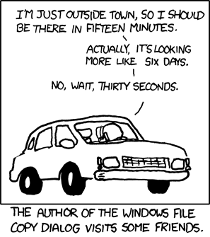
Is timing important?
Source: http://xkcd.com/612/

Slide 149
PBX-A9 Memory Map
Source: http://infocenter.arm.com/help/index.jsp?topic=/com.arm.doc.dui0440b/Bbajihec.html
Notes:
Source: http://infocenter.arm.com/help/index.jsp?topic=/com.arm.doc.dui0440b/Bbajihec.html

Slide 150
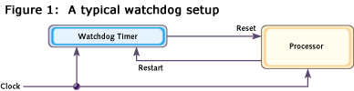
Watchdog timer
Usually used in embedded systems scenarios
A hardware timer that hard resets the system when it reaches zero
Up to system designer to make sure counter does not reach zero
Timer accessible through register
Reset @ critical code sections where deadlocks can occur
Source: http://www.eetimes.com/discussion/beginner-s-corner/4023849/Introduction-to-Watchdog-Timers

Slide 151
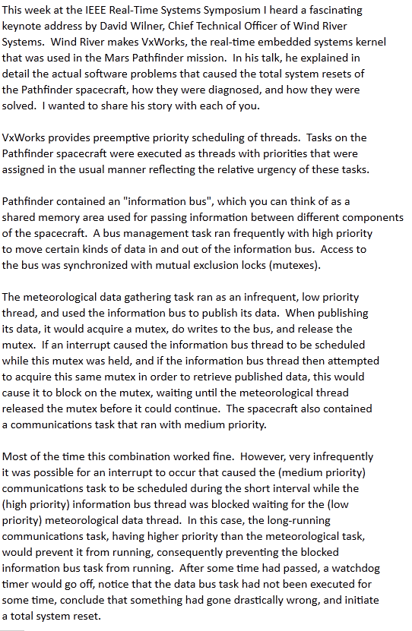
Interrupts & Watchdog timers
Is it worth it?
Meant for mainly RTOS
Helps recover from inconsistent state
However system designer has to specify “consistent state”
Source: http://catless.ncl.ac.uk/Risks/19.49.html

Slide 152
Interrupts introduction
Interrupts
can be synchronous (software generated)
can be asynchronous (hardware generated)
Literally interrupt the control flow of the program
Generated when
System power off/reset
Undefined instruction
Non-aligned memory access
Non-readable memory access
Page faults
…

Slide 153
Interrupt handlers
Referred to as ISR or Interrupt Service Routine
Use masks in registers to enable/disable interrupts
Section in memory that has addresses to ISRs called an Interrupt Vector table (usually located at 0x00000000)
Wire the handler by writing code directly at location in memory or roll your own lookup table code and insert into vector table

Slide 154
Interrupt Wiring
Exception type | Mode | Vector Address | Priority
Reset | Supervisor | 0x00000000 | 1 (highest)
Data Abort | Abort | 0x00000010 | 2
FIQ (Fast Interrupt) | FIQ | 0x0000001C | 3
IRQ (Normal Interrupt) | IRQ | 0x00000018 | 4
Prefetch Abort | Abort | 0x0000000C | 5
Sofware Interrupt (SWI/SVC) | Supervisor | 0x00000008 | 6
Undefined instruction | Undefined | 0x00000004 | 6 (lowest)

Slide 155
Interrupt vector table
0x1C
FIQ
0x18
IRQ
0x14
RESERVED
0x10
DATA ABORT
0x0C
PREFETCH ABORT
LDR PC, PC, #100
0x08
SWI
SWI Handler
0x04
UNDEFINED
0x6C
SWI Handler Code here…
0x00
RESET
0x70

Slide 156
Current Program Status Register
31
N
30
Z
29
C
27
28
1
26
25
24
23
22
21
20
19
18
17
16
15
14
13
12
11
10
9
8
7
6
5
4
3
2
0
V
Q
E
D
O
M
_
T
F
I
I – 1: Disable IRQ mode
F – 1: Disable FIQ mode
T – 0: ARM state
1: Thumb state
_MODE – Mode bits
_Mode [4:0] | Mode
10000 | User
10001 | FIQ
10010 | IRQ
10011 | SVC (Supervisor)
10111 | Abort
11011 | Undefined
11111 | System

Slide 157
Interrupt handlers II
When an exception occurs, processor
Copies CPSR into SPSR_<mode>
Changes CPSR bits to reflect new mode, and (ARM/Thumb) state
Disables further interrupts if appropriate
Stores PC + 4 (ARM) or PC + 2 (Thumb) in LR_<mode>
Sets PC to address from vector table corresponding to exception
When returning from an ISR
System developer needs to restore CPSR from SPSR_<mode>
Restore PC from LR_<mode>
Both can be done in one instruction MOVS PC, LR

Slide 158
Interrupt handlers III
When IRQ exception occurs, only IRQs are disabled
When FIQ exception occurs, both IRQs and FIQs are disabled
Generally each exception mode’s LR has previous PC + 4 (except for Data abort exception)
Data abort exception mode’s LR has previous PC + 8 (ARM & Thumb)
Source: http://www.csie.nctu.edu.tw/~wjtsai/EmbeddedSystemDesign/Ch3-1.pdf

Slide 159
Sample IRQ Handler
IRQ_Handler (ARM mode):
STMFD sp!, {r0-r12,lr}
BL ISR_IRQ @ Go to second level IRQ handler
SUB lr, lr, #4
LDMFD sp!, {r0-r12,lr}^
SUBS pc, lr, #4

Slide 160
Sample FIQ Handler
FIQ Handler
SUB lr, lr, #4
STMFD sp!, {r0-r7,lr}
@ Renable any interrupts needed here
MRS R0, CPSR
CMP R1, #0x00000012 ; Test for IRQ mode
BICNE R0, R0, #0x80 @ Optionally renable IRQs here
@ Handle FIQ event here
LDMFD sp!, {r0-r7,lr}^
SUBS pc, lr, #4

Slide 161
SWI (Software interrupt) handler wiring
Most hardware define vector tables indexed by exception type.
SWI handler address usually at 0x08
As was seen earlier, Linux syscalls use SWI
SWI encoding allows for 24-bit comment, which is generally ignored
Can be used for differentiating b/w types of SWI

Slide 162
SWI handler wiring contd…
SWI 0x18 -> 0x08 LDR PC, PC, 0x100 -> S_Handler
0x108 STMFD sp!, {r0-r12, lr}
0x10c MOV r1, sp
0x110 LDR r0, [lr, #-4]
0x114 BIC r0, r0, #0xff000000
… BL C_SWI_HANDLER
… LDMFD sp!, {r0-r12, lr};
… MOVS pc, lr
void C_SWI_Handler(int swi_num, …)
{
switch(swi_num) {
case 0x00: service_SWI1();
case 0x01: service_SWI2();
…
}
}
SWI instruction is stored in LR_<Mode>
Encoded with the 24-bit value
Mask that 24-bit value into r0
Branch to SWI Handler
Run the appropriate handler based on that value

Slide 163
Lab 3
Interrupts lab
Emulating a serial driver using UART
In order to see something interesting in this lab, we take the input character and add 1 to it
Modify inter.c and vectors.S files
Add one or more lines where it says
/* ADD CODE HERE */

Slide 164
inter.c
void __attribute__((interrupt)) irq_handler() {
/* echo the received character + 1 */
UART0_DR = UART0_DR + 1;
}

Slide 165
vectors.S
reset_handler:
/* set Supervisor stack */
LDR sp, =stack_top
/* copy vector table to address 0 */
BL copy_vectors
/* get Program Status Register */
MRS r0, cpsr
/* go in IRQ mode */
BIC r1, r0, #0x1F
ORR r1, r1, #0x12
MSR cpsr, r1
/* set IRQ stack */
LDR sp, =irq_stack_top
/* Enable IRQs */
BIC r0, r0, #0x80
/* go back in Supervisor mode */
MSR cpsr, r0
/* jump to main */
BL main
B .

Slide 166
Current Program Status Register
31
N
30
Z
29
C
27
28
1
26
25
24
23
22
21
20
19
18
17
16
15
14
13
12
11
10
9
8
7
6
5
4
3
2
0
V
Q
E
D
O
M
_
T
F
I
I – 1: Disable IRQ mode
F – 1: Disable FIQ mode
T – 0: ARM state
1: Thumb state
_MODE – Mode bits
_Mode [4:0] | Mode
10000 | User
10001 | FIQ
10010 | IRQ
10011 | SVC (Supervisor)
10111 | Abort
11011 | Undefined
11111 | System

Slide 167
ARM ELF Format
ELF Header
.init
.text
.rodata
.data
.bss
.symtab
.rel.text
.rel.data
.debug
.line
.strtab
Section header table
Read-only Code segment
Read/write Data segment
Symbol table and debugging info NOT loaded into memory

Slide 168
ARM ELF Format
.text – has your code
.rodata – has constants and read-only data
.data – has your global and static variables
.bss – contains uninitialized variables
Heap starts after .bss section in memory grows towards increasing memory
Stack starts at the opposite end and grows toward heap

Slide 169
ARM ELF Format
Section | Description
.text | Program instructions and data
.rodata | Read-only data like format strings for printf
.data | Initialized global data
.bss | Un-initialized global data
.symtab | This section has the symbol information such as global variables and functions
.rel.text | List of locations in the .text that linker needs to determine when combining .o files
.rel.data | Relocation information for global variables
.debug | Debugging informations (such as the one turned on with gcc –g)
.line | Mapping b/w line numbers in C program and machine code (debug)
.strtab | String table for symbols in .symtab and .debug

Slide 170
How to perform a control hijack
We can write to the SP given a vulnerable function (strcpy or memcpy with no bounds check into local variable)
ATPCS as we saw requires args to be passed in through R0-R3
For popping a shell we can make a system() with arguments containing string “/bin/sh”

Slide 171
ARM now executing first instruction in one()
Callee-save registers are pushed onto stack using STMFD sp!,{registers} along with R14 (LR)
And R11/R7/R3(FP) can also be updated relative to (R13)SP
…
Local variables
Caller-save registers
Increasing Memory
Args to One()
main() “frame”
LR = PC@main
One() “frame”
Callee-save registers
undefined

Slide 172
Itzhak Avraham’s approach
Use a return to libc style method
We can overwrite LR in stack
Return to a function that contains instructions to pop values from stack into R0 (containing our “/bin/sh” address) and another LR in stack pointing to system()
The above function that contains this code for us is erand48()
Source: https://media.blackhat.com/bh-dc-11/Avraham/BlackHat_DC_2011_Avraham-Popping_Android_Devices-Slides.pdf
Notes:
Source: https://media.blackhat.com/bh-dc-11/Avraham/BlackHat_DC_2011_Avraham-Popping_Android_Devices-Slides.pdf

Slide 173
Stack
string
Put “/bin/sh” string here
erand48()+x:
&system()
Point to system()
POP PC, LR
Junk
Junk value
SUB SP, #12
Increasing Memory
R1
R1: Can be junk
LDRD R0, R1
R0 for system()
R0: Point to /bin/sh
LR
Point to erand48()+x
Register val
Callee saved register(s)
Buf[5]
Buf[5]

Slide 174
Lab 4
Control flow hijack lab
Objective: Get a shell using return to libc style attack
Itzhak Avraham’s paper included
Other useful links:
http://research.shell-storm.org/files/research-4-en.php

Slide 175
Lab 4 Notes
IMPORTANT:
echo 0 > /proc/sys/kernel/randomize_va_space
In gdb you can breakpoint and run
p str // Gets address of /bin/sh string
p erand48 // Gets address of erand48 method
p system // Gets address of the system method
Remember to add 1 to the erand48 address (thumb2 instruction set requires LSB to be 1)
To verify run x/s <enter address from previous>

Slide 176
Lab 4 Notes contd…
To craft your exploit string run:
perl –e ‘print “ABCD”x3 . “\xAB\xCD\xDE\xEF” . “EFGH”’ > solution
gdb ./boverflow
“b stage1” or whatever is in your init commands file
run `cat solution`

Slide 177
Possible Solution
My erand48+x located at 0x76F28E56 + 1
My system located at 0x76F2D768 +1
My “/bin/sh” passed in through string located at 0x7EFFF6E8
As per the stack diagram I need “ABCD”x3 + 0x578EF276 + 0xE8F6FF7E + “EFGH” + “IJKL” + 0x69D7F276 + “/bin/sh”

Slide 178
Day 2 part 1.5

Slide 179
Code Optimization
Ok we can write assembly and C programs
However, do we know what really happens to that C program once we give it to the compiler?
We assume certain things happen for us
For example, dead code is removed
However with great compilers comes great responsibility…

Slide 180
GCC Optimizations
Can optimize for code size, memory usage
Usually compiler knows best, however can also be NOT what system designer has in mind.
We can help compiler decide
For more evil C, checkout http://www.steike.com/code/useless/evil-c/
int func1(int *a, int *b)
{
*a += *b;
*a += *b;
}
int func2(int *a, int *b)
{
*a += ((*b)<<1);
}
Source: Bryan, R., O’Hallaron, D. “Computer Systems: A Programmer’s Perspective”
Notes:
When a and b are same:
Func1: result is a = 4*a
Func2: result is a = 3*a

Slide 181
GCC optimizations 2
Common sub-expression elimination
Dead code removal
Use ifdefs helps compiler eliminate dead code
Induction variables & Strength reduction
Loop unrolling
Increases code size, but reduces the number of branches
Function inlining
Again can reduce number of branches
In C code, add __inline before function spec
Source: http://gcc.gnu.org/onlinedocs/
Notes:
What are the dangers of each?
Loop unrolling can also cause non-integer divides
Function inlining can increase code size
Both of the above can cause instruction cache performance degradation
Induction variables – variables that get incremented or decremented by fixed amount in a loop
Strength reduction – use addition instead of multiplication and can be used for induction variables
Source: http://gcc.gnu.org/onlinedocs/

Slide 182
ARM specific optimizations
Use of constants using barrel shifter:
Instead of 5*x, use (x<<2) + x
Use of conditional execution to reduce code size and execution cycles
Count down loops
Counting upwards produces ADD, CMP and B{x} instructions
Counting downwards produces SUBS & BGE
Use 32-bit data types as much as possible
Avoid divisions or remainder operation (%)
Register accesses more efficient than memory accesses
Avoid register spilling (more parameters than registers end up in memory on stack)
Use pure functions when possible and only if they do not have side effects

Slide 183
ARM specific optimization: Count down loops
int checksum(int *data)
{
unsigned i;
int sum = 0;
for(i=0; i<64; i++)
sum += *data++;
return sum;
}
int checksum(int *data)
{
unsigned i;
int sum = 0;
for(i=63; i>=0; i--)
sum += *data++;
return sum;
}
MOV r2, r0 ; r2=data
MOV r0 #0 ; sum=0
MOV r2, r0 ; r2=data
r0, MOV r1, #0; i=0
L1 LDR r3,[r2],#4 ; r3=*(data++)
ADD r1, r1, #1 ; i=i+1
CMP r1, 0x40 ; cmp r1, 64
ADD r0, r3, r0 ; sum +=r3
BCC L1 ; if i < 64, goto L1
MOV pc, lr ; return sum
MOV r2, r0 ; r2=data
MOV r0, #0 ; sum=0
MOV r1, #0x3f ; i=63
L1 LDR r3,[r2],#4 ; r3=*(data++)
ADD r0, r3, r0 ; sum +=r3
SUBS r1, r1, #1 ; i--, set flags
BGE L1 ; if i >= 0, goto L1
MOV pc, lr ; return sum

Slide 184
ARM specific optimization: 32-bit data types
void t4(void)
{
int c;
int x=0;
for(c=0;c<63;c++)
x++;
}
void t3(void)
{
char c;
int x=0;
for(c=0;c<63;c++)
x++;
}
MOV r0,#0 ; x=0
MOV r1,#0 ; c=0
L1 CMP r1,#0x3f ; cmp c with 63
BCS L2 ; if c>= 63, goto L2
ADD r0,r0,#1 ; x++;
ADD r1,r1,#1 ; c++
AND r1,r1,#0xff ; c=(char) r1
B L1 ; branch to L1
L2 MOV pc,r14
Notes:
ARM likes to use 32-bit data types as much as possible
If you use char, it forces a check to ensure it does not exceed 255

Slide 185
ARM specific optimization: function calls
void test(int x) {
return(square(x*x) + square(x*x));
}
void test(int x) {
return(2*square(x*x));
}
The following case shows square() has a side effect:
int square(int x)
{
counter++; /* counter is a global variable */
return(x*x);
}
If no side effect, declare as pure function for compiler to optimize
__pure int square(int x);
Notes:
If no side-effects as seen in this example, declare function as pure which means function depends only on the input parameters and nothing else!

Slide 186
ARM specific optimization: code alignment
Structure/Code alignment
12 bytes vs. 8 bytes
Could use __packed keyword to remove padding
However ARM emulates unaligned load/store by using several aligned byte access (inefficient)
struct
{
char a;
int b;
char c;
short d;
}
struct
{
char a;
char c;
short d;
int b;
}

Slide 187
Day 2 part 2

Slide 188
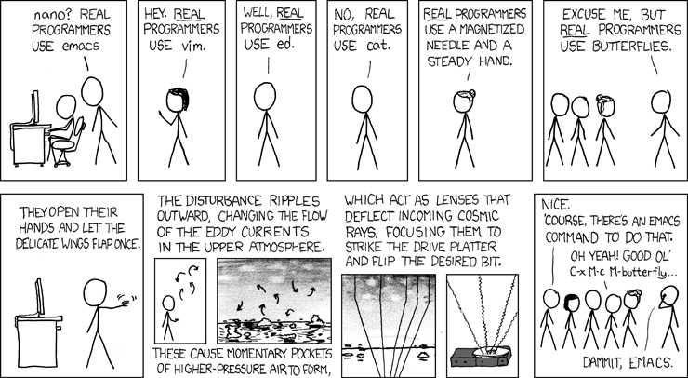
Writing assembly in whatever your editor may be…
Source: http://xkcd.com/378/

Slide 189
Inline assembly (using butterflies)
Follows the following form:
asm(code : output operand list : input operand list: clobber list);
The input/output operand list includes c and assembly variables
Example:
/* Rotating bits example */
asm("mov %[result], %[value], ror #1" : [result] "=r" (y) : [value] "r" (x));
“=r”
r is referred to as a constraint
= is referred to as a modifier
Source: http://www.ethernut.de/en/documents/arm-inline-asm.html

Slide 190
Possible constraints for inline assembly
Constraint | Usage in ARM state | Usage in Thumb state
F | Floating point registers f0..f7 | Not Available
H | Not Available | Registers r8..r15
G | Immediate floating point constant | Not available
H | Same a G, but negated | Not available
I | Immediate value in data processing instructions e.g. ORR R0, R0, #operand | Constant in the range 0 .. 255 e.g. SWI operand
J | Indexing constants -4095 .. 4095 e.g. LDR R1, [PC, #operand] | Constant in the range -255 .. -1 e.g. SUB R0, R0, #operand
K | Same as I, but inverted | Same as I, but shifted
L | Same as I, but negated | Constant in the range -7 .. 7 e.g. SUB R0, R1, #operand
l | Same as r | Registers r0..r7 e.g. PUSH operand
M | Constant in the range of 0 .. 32 or a power of 2 e.g. MOV R2, R1, ROR #operand | Constant that is a multiple of 4 in the range of 0 .. 1020 e.g. ADD R0, SP, #operand
m | Any valid memory address
N | Not available | Constant in the range of 0 .. 31 e.g. LSL R0, R1, #operand
O | Not available | Constant that is a multiple of 4 in the range of -508 .. 508 e.g. ADD SP, #operand
r | General register r0 .. r15 e.g. SUB operand1, operand2, operand3 | Not available
w | Vector floating point registers s0 .. s31 | Not available
X | Any operand
Source: http://www.ethernut.de/en/documents/arm-inline-asm.html

Slide 191
Modifiers
= is write-only operand, usually for all output operands
+ is read-write operand, must be listed as an output operand
& is a register that should be used for output only
Source: http://www.ethernut.de/en/documents/arm-inline-asm.html

Slide 192
Example 6.c
int main(void)
{
int a, b;
a = 6;
asm(“mrs %[result], apsr”: [result] “=r” (x) : );
b = a - 182947;
asm(“mrs %[result], apsr”: [result] “=r” (y) : );
printf("a's negatory is %d\n", b);
return 0;
}
0000838c <main>:
838c: b590 push {r4, r7, lr}
838e: b085 sub sp, #20
8390: af00 add r7, sp, #0
8392: f04f 0306 mov.w r3, #6
8396: 60fb str r3, [r7, #12]
8398: f3ef 8400 mrs r4, CPSR
839c: 60bc str r4, [r7, #8]
839e: 68fa ldr r2, [r7, #12]
83a0: f243 535d movw r3, #13661 ; 0x355d
83a4: f6cf 73fd movt r3, #65533 ; 0xfffd
83a8: 18d3 adds r3, r2, r3
83aa: 607b str r3, [r7, #4]
83ac: f3ef 8400 mrs r4, CPSR
83b0: 603c str r4, [r7, #0]
83b2: f248 4344 movw r3, #33860 ; 0x8444
83b6: f2c0 0300 movt r3, #0
83ba: 4618 mov r0, r3
83bc: 6879 ldr r1, [r7, #4]
...
Before the subtraction operation
APSR = 0x60000010
After the subtraction operation
APSR = 0x80000010

Slide 193
Writing C functions in assembly
In C file, say it is called isawesome.c, declare the function:
extern int mywork(int arg1, char arg2, …);
In assembly include
.syntax unified @ For UAL
.arch armv7-a
.text
.align 2
.thumb
.thumb_func
.global mywork
.type mywork, function
@ CODE HERE
.size mywork, .-mywork
.end
In make file use gcc –c –o mywork.o mywork.s
Finally gcc –o awesomeprogram mywork.o isawesome.o
Source: http://omappedia.org/wiki/Writing_ARM_Assembly

Slide 194
Event handling
WFE – Wait for Event, wakes up when either of following happens:
SEV is called
A physical IRQ interrupt
A physical FIQ interrupt
A physical asynchronous abort
SEV – Send Event
See B 1.8.13 in manual for more details
Used with spin-locks

Slide 195
Exclusive instructions
LDREX{B|D|H} <reg1> <Rm>
Load exclusive from Rm into <reg1>
STREX{B|D|H} <reg1> <reg2> <Rm>
Store exclusive from <reg2> into <Rm> and write to <reg1> with 0 if successful or 1 if unsuccessful
Both introduced since ARMv6
SWP & SWPB – Used on ARMv6 and earlier now deprecated
It is read-locked-write
However does not allow for operations between the read lock and write
At that point you use LDREX/STREX

Slide 196
Exclusive instructions contd…
No memory references allowed between LDREX and STREX instructions
However after starting exclusive access using LDREX, can disengage using CLREX instruction
Use of DMB (Data Memory Barrier) in between exclusive accesses
Ensures correct ordering of memory accesses
Ensures all explicit memory accesses finish or complete before explicit memory access after the DMB instruction

Slide 197
Lab 5
Atomic lab
Implement a simple mutex in assembly with threads in C
Given code that uses libpthread to do threading
Creates two threads which use dosomething() to do work

Slide 198
Lab 5
Pseudocode for mutex_lock:
Load locked value into a temp register
Loop:
LDREX from [r0] and compare to unlocked value
If [r0] contents have the unlocked value
STREX value in temp variable into [r0]
If not successful goto loop
To load locked value, you can use
ldr r2, =locked
Pseudocode for Mutex unlock
Load =unlocked value into a temp register
Store value from temp register into [r0]

Slide 199
Possible solution
.equ locked, 1
.equ unlocked, 0
.global lock_mutex
.type lock_mutex, function
lock_mutex:
ldr r1, =locked
.L1:
ldrex r2, [r0]
cmp r2, #0
strexeq r2, r1, [r0]
cmpeq r2, #0
bne .L1
bx lr
.size lock_mutex, .-lock_mutex
@.align 2
@.thumb
@.thumb_func
.global unlock_mutex
.type unlock_mutex, function
unlock_mutex:
ldr r1, =unlocked
str r1, [r0]
bx lr
.size unlock_mutex, .-unlock_mutex

Slide 200
Assembly on iPhone
For iPhone:
Can use Inline assembly as we saw above in Objective-C code
Include the assembly source file in XCode
Have not experimented with Xcode and assembly
iPhone ABI Link:
http://developer.apple.com/library/ios/documentation/Xcode/Conceptual/iPhoneOSABIReference/iPhoneOSABIReference.pdf
Source:

Slide 201
Assembly on Android
For Android:
Need to use Android Native Development Kit (NDK)
Write a stub code in C that calls assembly method and uses JNI types
Write a make file or copy a template and include the new assembly file and the stub-code C file
Use NDK tool ndk-build to build
In Android application declare the method using same signature using Java types and mark as native
public native int myasmfunc(int param1);
Also load the assembly jni-library
System.loadlibrary(“library-name-here”);
Source: http://www.eggwall.com/2011/09/android-arm-assembly-calling-assembly.html

Slide 202
Summary
We covered:
How boot is handled on ARM platforms
Some mechanics of ARM assembly and how to debug it using GDB
How programs are converted to assembly and run including ATPCS along with control flow hijack vulnerabilities
Other features of ARM platforms including interrupts and atomic instructions
How to write inline assembly in C and how to write C functions in assembly (for use in C source)

Slide 203
Useful links
ARM GCC Inline Assembler cookbook
http://www.ethernut.de/en/documents/arm-inline-asm.html
Writing ARM assembly
http://omappedia.org/wiki/Writing_ARM_Assembly
ARM architecture diagrams:
http://www.eng.auburn.edu/~agrawvd/COURSE/E6200_Fall08/CLASS_TALKS/armcores.ppt
How to build the emulator:
https://developer.mozilla.org/en/Developer_Guide/Virtual_ARM_Linux_environment
GCC manual (ARM optimization options):
http://gcc.gnu.org/onlinedocs/gcc/ARM-Options.html

